Slide 1

Driven By Data
Hack-A-Roo Spring 2022

Slide 2
CONTENTS
INTRODUCTION
PURPOSE
DATASET
CURRENT FEATURES
DEEP LEARNING MODEL
LIVE DEMO

Slide 3
INTRODUCTION
The project deals with the automobile accidents happening due to the drowsy driving. With the help of Deep learning, we can detect the Real time facial expressions and alert the user when the user is getting drowsy/sleepy.
The Main Objective is to reduce the accidents happening caused by drowsiness/sleepiness while user is driving an automobile.
we are using Real time continuous images/video monitoring of users face and analyzing them using deep learning trained data sets which alerts the user when he is drowsy/sleepy.

Slide 4
DATASET
We have used MRL Eye Dataset(MRL Eye Dataset | MRL (vsb.cz))
Dataset contains the dataset consists of 84,898 images.
Contains Male and Female images with glasses and without glasses
Images contain open and closed eyes
Each image has two states (bad, good) based on the amount of light during capturing the videos

Slide 5
Current Features
We have built a deep learning model which classifies if the person is drowsy or active.
If the Person is drowsy our model detects and raise a beep sound

Slide 6
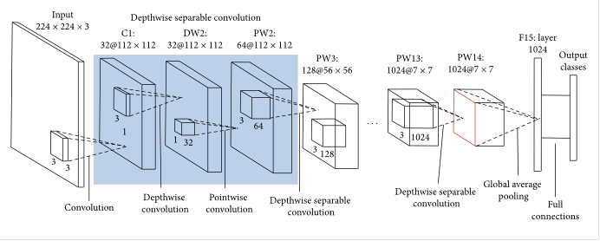
Deep Learning Model
We have developed light weight drowsiness detector using Transfer Learning.
We have used Tensorflow Lite MobileNet Model till dropout layer and added additional layers to detect drowsiness

Slide 7
Thank you
Git hub link: ashok-karanam/Hack-A-Roo (github.com)
Video Link: https://youtu.be/OjmRnaPUKfI

